Slide 1
ACADEMIC WRITING AND LITERACY: HOW TO APPROACH ASSIGNEMENT TOPICS BY MR S SIRAYI (ACADEMIC ADVISOR AND LECTURER)

Slide 2
Workshop content
After completing this workshop, you will be able to:
know where to start with your assignment
generate ideas using brainstorming or freewriting method
gathering and organising information for your assignment
keep a record of bibliographical information
draw up a mind-map
structure your assignment
write guidelines for different sections of your assignment
write a conclusion that is appropriate for an academic assignment
check and edit your assignment
Get feedback from your friends

Slide 3
1. Where to start?
1.1 Unpack the topic
Before you start to write an assignment, you need to understand the following:
the topic
the instructions
what type of assignment (genre)
what research you should do
the technical requirements
Notes:
Good introduction

Slide 4
Where to start?
1.2 Use a dictionary
Use a dictionary to clarify the meaning of instruction words and key words in your assignment instructions
keep your dictionary handy throughout the process of writing
Remember that the same word might mean different things in different contexts
Make sure that you have taken the correct meaning for a particular word
Speak to the lecturer who assigned the task about the meanings of any words you are not sure of
There are several high quality dictionaries that you can use online for free
Collins Dictionary: https://www.collinsdictionary.com/
Macmillan Dictionary: https://www.macmillandictionary.com/

Slide 5
2. Generate ideas
Generate ideas and write them down so that you can get started with writing
You can use various methods to do this, such as freewriting and brainstorming
Brainstorming method example:

Slide 6
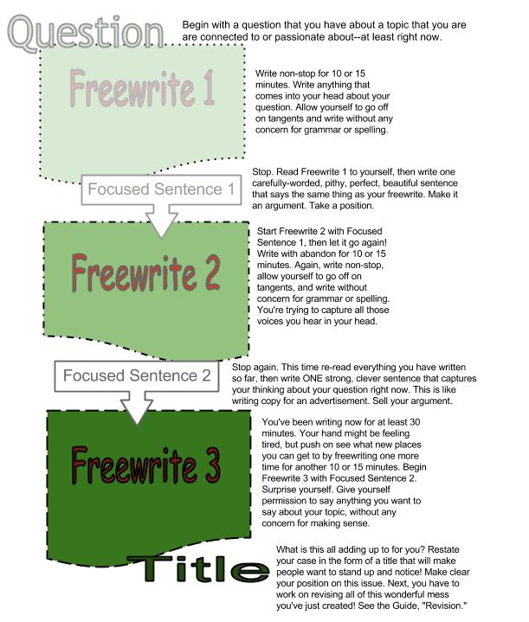
Generate ideas
Freewriting method example:

Slide 7
What is your suitable method of approaching assignment?
How has the method contributed to your academic writing?

Slide 8
3. Gathering and organising information
To gather information, you need to consider the following:
What information do you have?
What information do you need?
Where can the right information be found?
Two things make selecting appropriate resource material tricky:
The overwhelming amount of resources available
The speed at which information becomes outdated

Slide 9
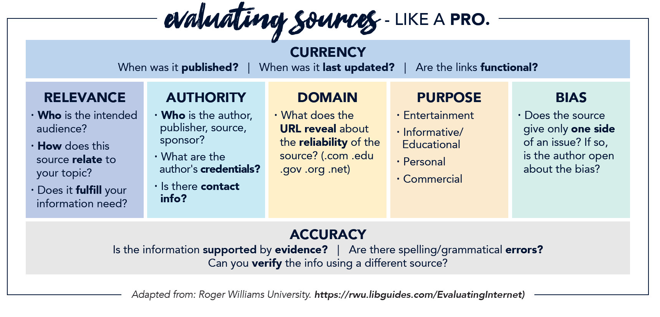
3.1 Evaluating Sources like a pro
Consider all of the following when evaluating resource material (boos, e-books, articles, and website) to use for your assignment:

Slide 10
4. Keeping a record of bibliographical info
A filing-card system is a very useful system to keep record of your bibliographical information
Bibliographical information could be written onto:
cards
sticky notes
Filed in your computer
Consider the following example for five pieces of information for each resource material:
Author’s surname and initials
Date
Title of book or article
City/place/journal where published
Publisher or website
Page numbers

Slide 11
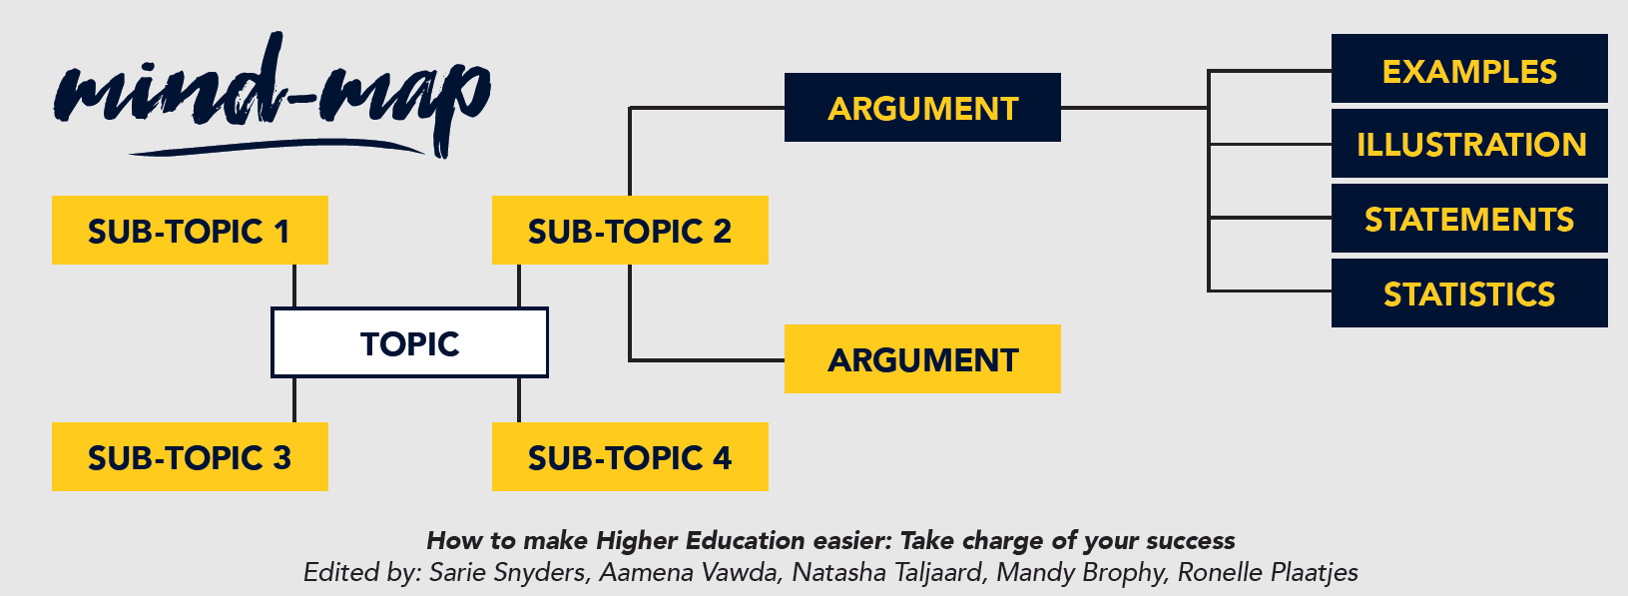
5. Draw up a mind-map
Once you have your information, you can organise it using mind-maps or tables
Usefulness of mind-maps:
To organise material visually
To organise many related ideas in such a way as to see how they all fit together
To introduce a topic and then use branches to create smaller and smaller divisions
Consider the following example:

Slide 12
6. Structuring your assignment
Structuring an assignment means deciding exactly where to place the different kinds of information you have gathered from your reading (such as topics, arguments, opinions, and quotes)
Having a structure of an assignment helps you to know:
exactly what you are going to write before you start
what information is the most important
which pieces of information belong together
in what order issues should be addressed
how to begin and conclude your writing

Slide 13
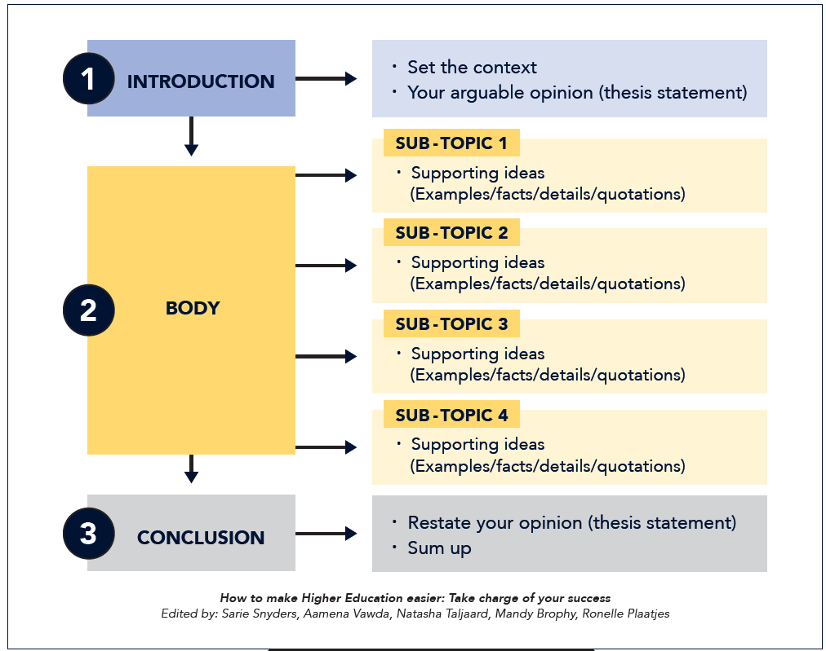
6.1 Example of the structure of a research assignment
Here is the structure of a research assignment presented in the form of a mind map:

Slide 14
6.2 Develop a thesis or opinion statement
A thesis statement may be described as the main point that you wish to make in your assignment
It is the idea, opinion or point of view that you aim to support through reasoning and evidence
The thesis is usually stated clearly in the introduction
Your thesis should:
take the form of a single overall claim in no more than two sentences
show your reader exactly where you stand regarding an issue
not take the form of a question

Slide 15
6.2.1 Examples of a thesis or opinion statement
Source: Thesis Statement Example | Write the Perfect Statement (bachelorprint.eu)

Slide 16
7. Guidelines for writing different sections of your assignment
Writing an introduction
In order to write an introduction that is appropriate for an academic assignment:
Set the context
Put forward your thesis (your opinion/point of view)
Outline the issues (sub-topics) you are going to discuss in the order in which they will be discussed
Writing a suitably structured paragraphs
The body (middle section) of an assignment consists of paragraphs. It is essential to structure paragraphs according to a pattern and to establish a logical thread which runs from sentence to sentence.
When completing the body of your assignment/essay, ensure that you:
Reference accurately
Quote correctly
Integrate your references and quotations suitably
Organise your structure

Slide 17
8. Writing a conclusion that is appropriate for an academic assignment
Since your concluding remarks give lecturers, supervisors, and examiners a final, and usually lasting, impression of your work, your conclusion should:
Refer to the thesis statement set out in the introduction
Sum up the argument, drawing together all threads developed in the body
Make one or two general concluding remarks regarding the topic
Definitely not include new information

Slide 18
8.1 Conclusion example for an academic assignment
“The purpose of this research was to identify effective strategies for dealing with repetitive motions identified in individuals with Autism Spectrum Disorder. Based on the analysis conveyed, it can be concluded that there are multiple behaviour modification therapies important for the improvement of this behaviour. Future exploration into behaviour modification techniques could be useful to finding further therapy techniques. The amount this could improve the lives of others with repetitive motion behaviours is worth exploring”.
Source: Conclusion Examples: Strong Endings for Any Paper (yourdictionary.com).

Slide 19
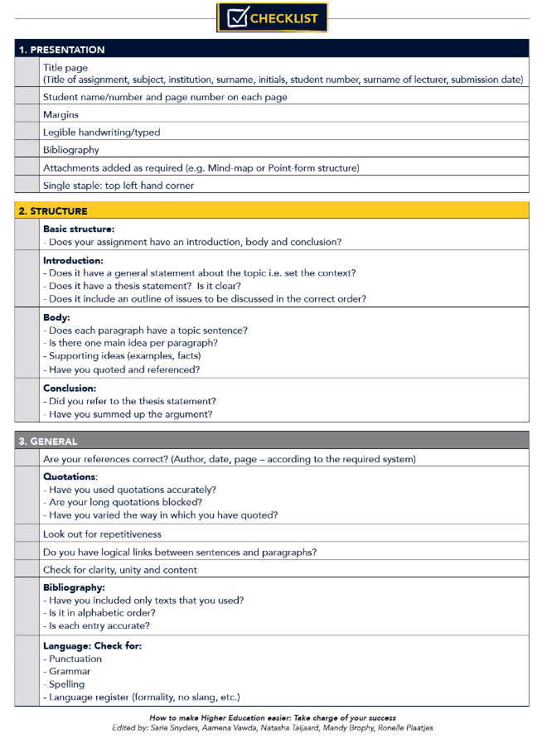
9. Checking and editing your assignment
Revise and check your written assignment using the following examples:

Slide 20
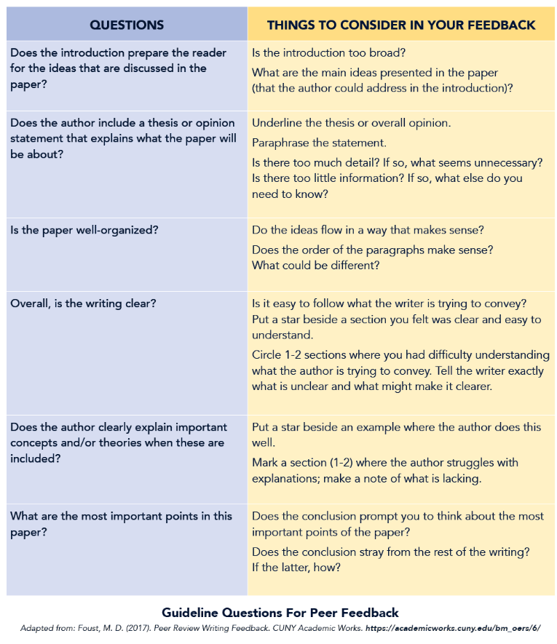
10. Get feedback from your friends
When your friends for feedback you could ask them to use the following guide:

