Slide 1
STUDY STRATEGIES AND TECHNIQUES BY MR S SIRAYI (ACADEMIC ADVISOR AND LECTURER)

Slide 2
Workshop content
This workshop is looking to equip students with three popular modern study strategies as listed below and how these strategies can be applied on your daily academic activities.
Study strategy 1: Underlining or highlighting (Marking)
Study strategy 2: Note-taking
Study strategy 3: Re-reading

Slide 3
Underlining or Highlighting
Underlining is one of the popular best strategies that is convenient to use.
Students can recall and understand the marked or underlined information in a text better.
The best effective way of marking important information is after the first reading of the section or text.
Lecture slides are usually the guidelines on how to go about marking important information in the textbook.
Notes:
Good introduction

Slide 4
Underlining or Highlighting
The underlining (marking) important information can benefit students in two ways:
Generative function
Storage function
Generative function – selecting what is important in a text point out elaborative thinking.
Storage function – underlining important information makes it more convenient to identify the information later.
Notes:
Good introduction

Slide 5
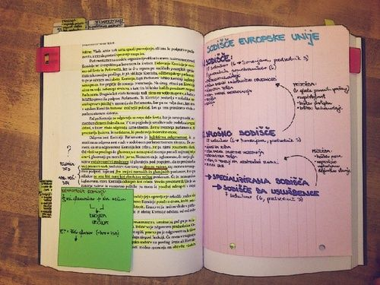
Underlining or highlighting example

Slide 6
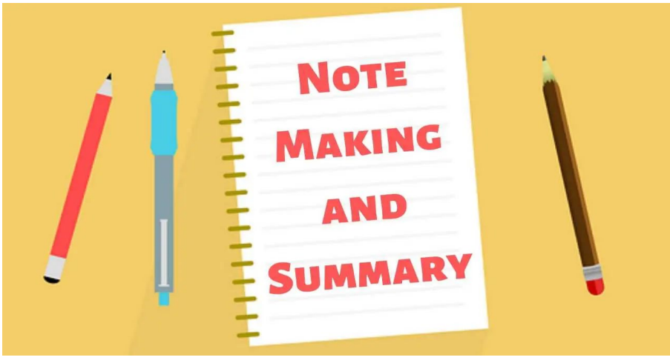
Note taking
Note taking has been proven to be the most effective way of studying for most students.
The advantages of note taking are that:
It saves a lot of time.
Students are able to identify main information quicker.
It improves students ability to remember their work for assignments, tests, and presentations.
It increases student’s chances to succeed quicker at university and college level.
It is a guide post in what is important and not.

Slide 7
Note taking tips
When taking notes during mass lecture, consider the following hints:
Make your notes brief
Use abbreviations and symbols, but be consistent.
abbreviations would be: dept for department, max for maximum, mn for minimum, cf for compare.
Symbols would be: = for equals, # for number, x for times, > for greater than, more, larger, < for less than, smaller, fewer.
Do not try to use every space on your page (leave a space for coordinating your notes with the text as soon as possible after the lecture).
Date your notes.
Use page numbers.
Use numbers: “one” for 1, third” for 3rd.
Use apostrophes: “Gov’t for government, Cont’d for continued

Slide 8
How do you note important information during a mass lecture?

Slide 9
Noting important information during mass lecture
Here are some hints that lecturers give in class and listen out for:
• Material written on the blackboard/transparencies.
• Repetition.
• Emphasis by:
Tone of voice and gesture
The amount of time the lecturer spends on points and the number of examples used
• Words signals such as “remember this”, “this is important”.
•Summaries given at the end of lecture.
•Reviews given at the beginning of lecture.

Slide 10
Re-reading
Re-reading is an under utilised or used strategy most students do not understand how re-reading can be different from initial reading.
Re-reading is more useful for examinations or EMSs, assignments, and presentations.
Ways to utilise effective re-reading:
Re-read a section or specific topic two times, then write a summary of important points.
After summarising, create two or three test questions to test your understanding of the summarised topic or section.
If your understanding and test score is 75% and above, then your re-reading is effective enough.

Slide 11
Re-reading strategy process
Read and pause
Re-read and think
Re-read and re-call
Re-read same section and re-call it out loud (empty chair technique)
Read a section for 10 minutes and pause
Re-read same section and think of important points

Slide 12
Which one of the three study strategies do you think will be useful for your academic success?

Slide 13
Academic Advisor contact information: Mr Sirayi Siyabonga.Sirayi@mandela.ac.za dept: Business Management South campus

